Slide 1


Lab 10
NN, ReLu, Xavier, Dropout, and Adam
With TF 1.0!
Sung Kim <hunkim+ml@gmail.com>
Code: https://github.com/hunkim/DeepLearningZeroToAll/

Slide 2

Call for comments
Please feel free to add comments directly on these slides
Other slides: https://goo.gl/jPtWNt
Picture from http://www.tssablog.org/archives/3280

Slide 3
Lab 10
NN, ReLu, Xavier, Dropout, and Adam
With TF 1.0!
Sung Kim <hunkim+ml@gmail.com>
Code: https://github.com/hunkim/DeepLearningZeroToAll/

Slide 4

https://github.com/hunkim/DeepLearningZeroToAll/

Slide 5
# weights & bias for nn layers
W = tf.Variable(tf.random_normal([784, 10]))
b = tf.Variable(tf.random_normal([10]))
hypothesis = tf.matmul(X, W) + b
# define cost/loss & optimizer
cost = tf.reduce_mean(tf.nn.softmax_cross_entropy_with_logits(logits=hypothesis, labels=Y))
optimizer = tf.train.AdamOptimizer(learning_rate=learning_rate).minimize(cost)
# initialize
sess = tf.Session()
sess.run(tf.global_variables_initializer())
# train my model
for epoch in range(training_epochs):
avg_cost = 0
total_batch = int(mnist.train.num_examples / batch_size)
for i in range(total_batch):
batch_xs, batch_ys = mnist.train.next_batch(batch_size)
feed_dict = {X: batch_xs, Y: batch_ys}
c, _ = sess.run([cost, optimizer], feed_dict=feed_dict)
avg_cost += c / total_batch
print('Epoch:', '%04d' % (epoch + 1), 'cost =', '{:.9f}'.format(avg_cost))
print('Learning Finished!')
# Test model and check accuracy
correct_prediction = tf.equal(tf.argmax(hypothesis, 1), tf.argmax(Y, 1))
accuracy = tf.reduce_mean(tf.cast(correct_prediction, tf.float32))
print('Accuracy:', sess.run(accuracy, feed_dict={X: mnist.test.images, Y: mnist.test.labels}))
Softmax classifier for MNIST
Epoch: 0001 cost = 5.888845987
Epoch: 0002 cost = 1.860620173
Epoch: 0003 cost = 1.159035648
Epoch: 0004 cost = 0.892340870
Epoch: 0005 cost = 0.751155428
Epoch: 0006 cost = 0.662484806
Epoch: 0007 cost = 0.601544010
Epoch: 0008 cost = 0.556526115
Epoch: 0009 cost = 0.521186961
Epoch: 0010 cost = 0.493068354
Epoch: 0011 cost = 0.469686249
Epoch: 0012 cost = 0.449967254
Epoch: 0013 cost = 0.433519321
Epoch: 0014 cost = 0.419000337
Epoch: 0015 cost = 0.406490815
Learning Finished!
Accuracy: 0.9035
https://github.com/hunkim/DeepLearningZeroToAll/blob/master/lab-10-1-mnist_softmax.py

Slide 6
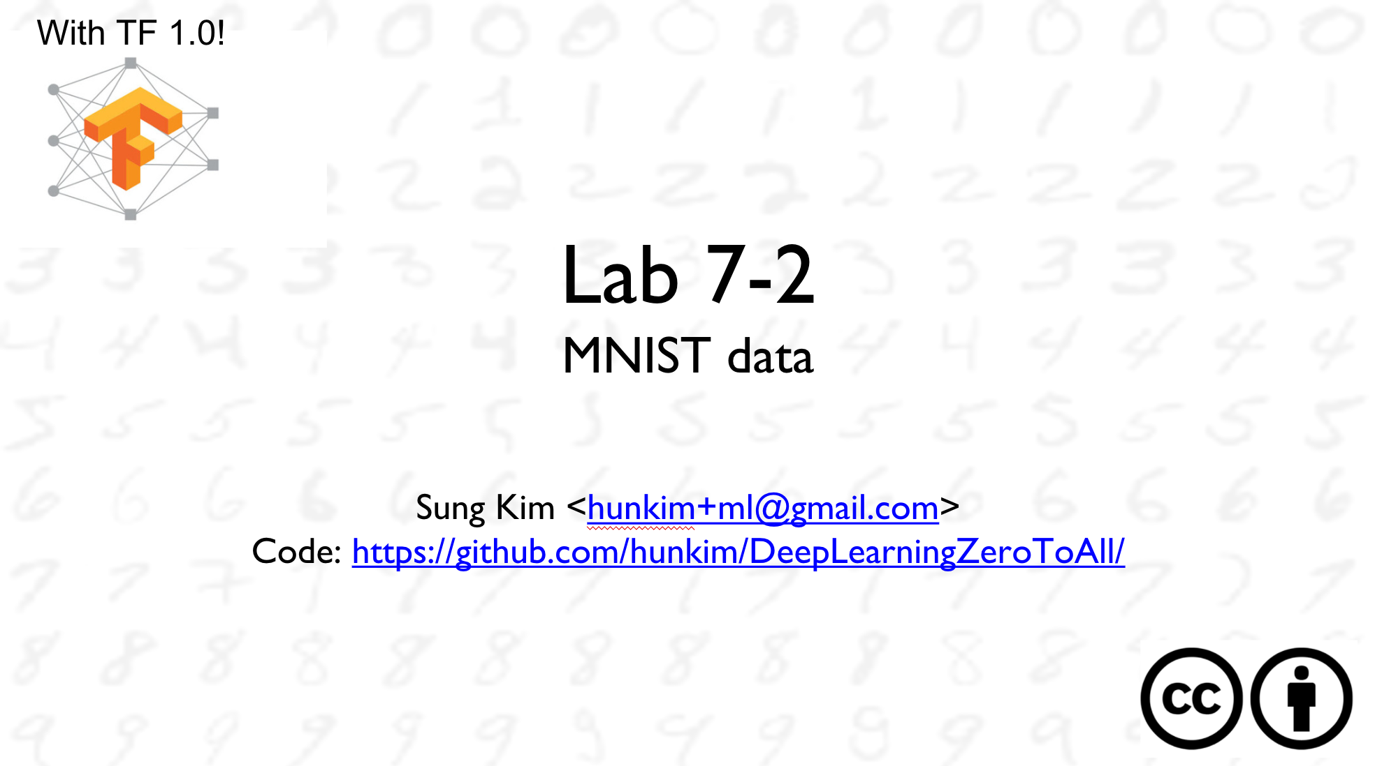

Slide 7
# weights & bias for nn layers
W = tf.Variable(tf.random_normal([784, 10]))
b = tf.Variable(tf.random_normal([10]))
hypothesis = tf.matmul(X, W) + b
# define cost/loss & optimizer
cost = tf.reduce_mean(tf.nn.softmax_cross_entropy_with_logits(logits=hypothesis, labels=Y))
optimizer = tf.train.AdamOptimizer(learning_rate=learning_rate).minimize(cost)
# initialize
sess = tf.Session()
sess.run(tf.global_variables_initializer())
# train my model
for epoch in range(training_epochs):
avg_cost = 0
total_batch = int(mnist.train.num_examples / batch_size)
for i in range(total_batch):
batch_xs, batch_ys = mnist.train.next_batch(batch_size)
feed_dict = {X: batch_xs, Y: batch_ys}
c, _ = sess.run([cost, optimizer], feed_dict=feed_dict)
avg_cost += c / total_batch
print('Epoch:', '%04d' % (epoch + 1), 'cost =', '{:.9f}'.format(avg_cost))
print('Learning Finished!')
# Test model and check accuracy
correct_prediction = tf.equal(tf.argmax(hypothesis, 1), tf.argmax(Y, 1))
accuracy = tf.reduce_mean(tf.cast(correct_prediction, tf.float32))
print('Accuracy:', sess.run(accuracy, feed_dict={X: mnist.test.images, Y: mnist.test.labels}))
Softmax classifier for MNIST
Epoch: 0001 cost = 5.888845987
Epoch: 0002 cost = 1.860620173
Epoch: 0003 cost = 1.159035648
Epoch: 0004 cost = 0.892340870
Epoch: 0005 cost = 0.751155428
Epoch: 0006 cost = 0.662484806
Epoch: 0007 cost = 0.601544010
Epoch: 0008 cost = 0.556526115
Epoch: 0009 cost = 0.521186961
Epoch: 0010 cost = 0.493068354
Epoch: 0011 cost = 0.469686249
Epoch: 0012 cost = 0.449967254
Epoch: 0013 cost = 0.433519321
Epoch: 0014 cost = 0.419000337
Epoch: 0015 cost = 0.406490815
Learning Finished!
Accuracy: 0.9035
https://github.com/hunkim/DeepLearningZeroToAll/blob/master/lab-10-1-mnist_softmax.py

Slide 8
# input place holders
X = tf.placeholder(tf.float32, [None, 784])
Y = tf.placeholder(tf.float32, [None, 10])
# weights & bias for nn layers
W1 = tf.Variable(tf.random_normal([784, 256]))
b1 = tf.Variable(tf.random_normal([256]))
L1 = tf.nn.relu(tf.matmul(X, W1) + b1)
W2 = tf.Variable(tf.random_normal([256, 256]))
b2 = tf.Variable(tf.random_normal([256]))
L2 = tf.nn.relu(tf.matmul(L1, W2) + b2)
W3 = tf.Variable(tf.random_normal([256, 10]))
b3 = tf.Variable(tf.random_normal([10]))
hypothesis = tf.matmul(L2, W3) + b3
# define cost/loss & optimizer
cost = tf.reduce_mean(tf.nn.softmax_cross_entropy_with_logits(
logits=hypothesis, labels=Y))
optimizer = tf.train.AdamOptimizer(learning_rate=learning_rate).minimize(cost)
NN for MNIST
Epoch: 0001 cost = 141.207671860
Epoch: 0002 cost = 38.788445864
Epoch: 0003 cost = 23.977515479
Epoch: 0004 cost = 16.315132428
Epoch: 0005 cost = 11.702554882
Epoch: 0006 cost = 8.573139748
Epoch: 0007 cost = 6.370995680
Epoch: 0008 cost = 4.537178684
Epoch: 0009 cost = 3.216900532
Epoch: 0010 cost = 2.329708954
Epoch: 0011 cost = 1.715552875
Epoch: 0012 cost = 1.189857912
Epoch: 0013 cost = 0.820965160
Epoch: 0014 cost = 0.624131458
Epoch: 0015 cost = 0.454633765
Learning Finished!
Accuracy: 0.9455
https://github.com/hunkim/DeepLearningZeroToAll/blob/master/lab-10-2-mnist_nn.py

Slide 9
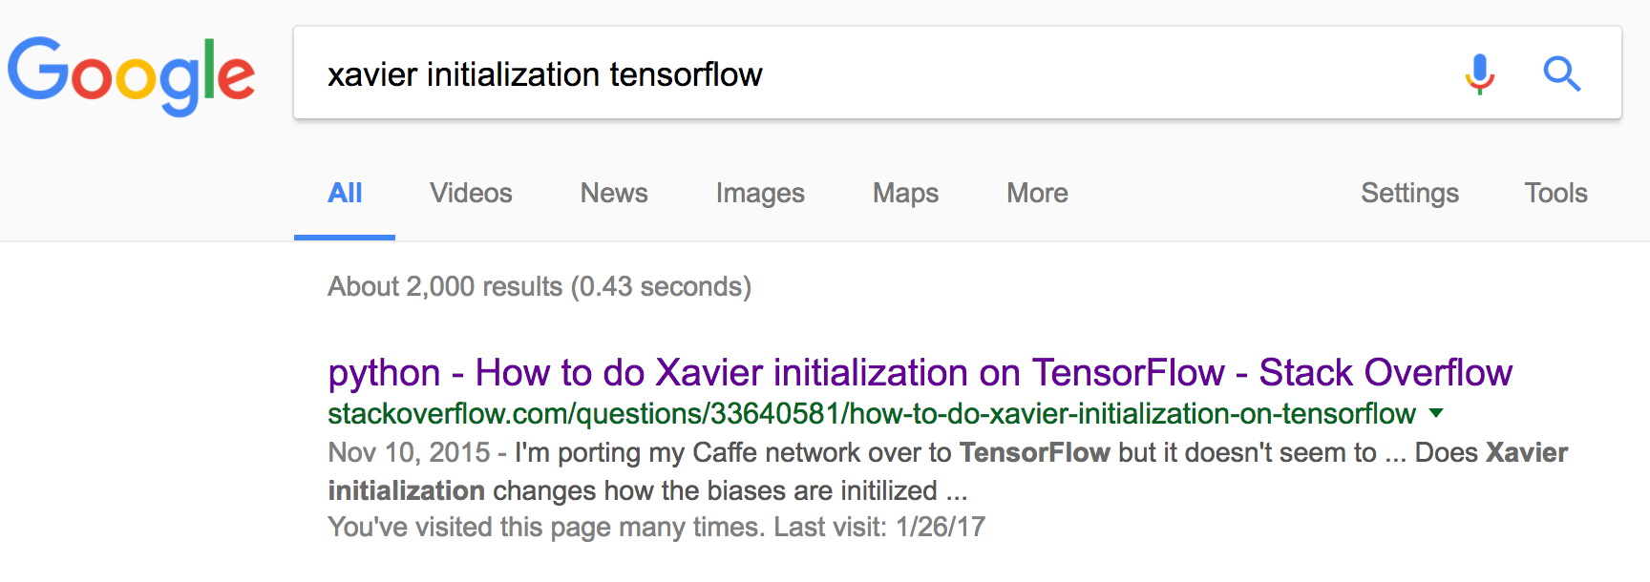
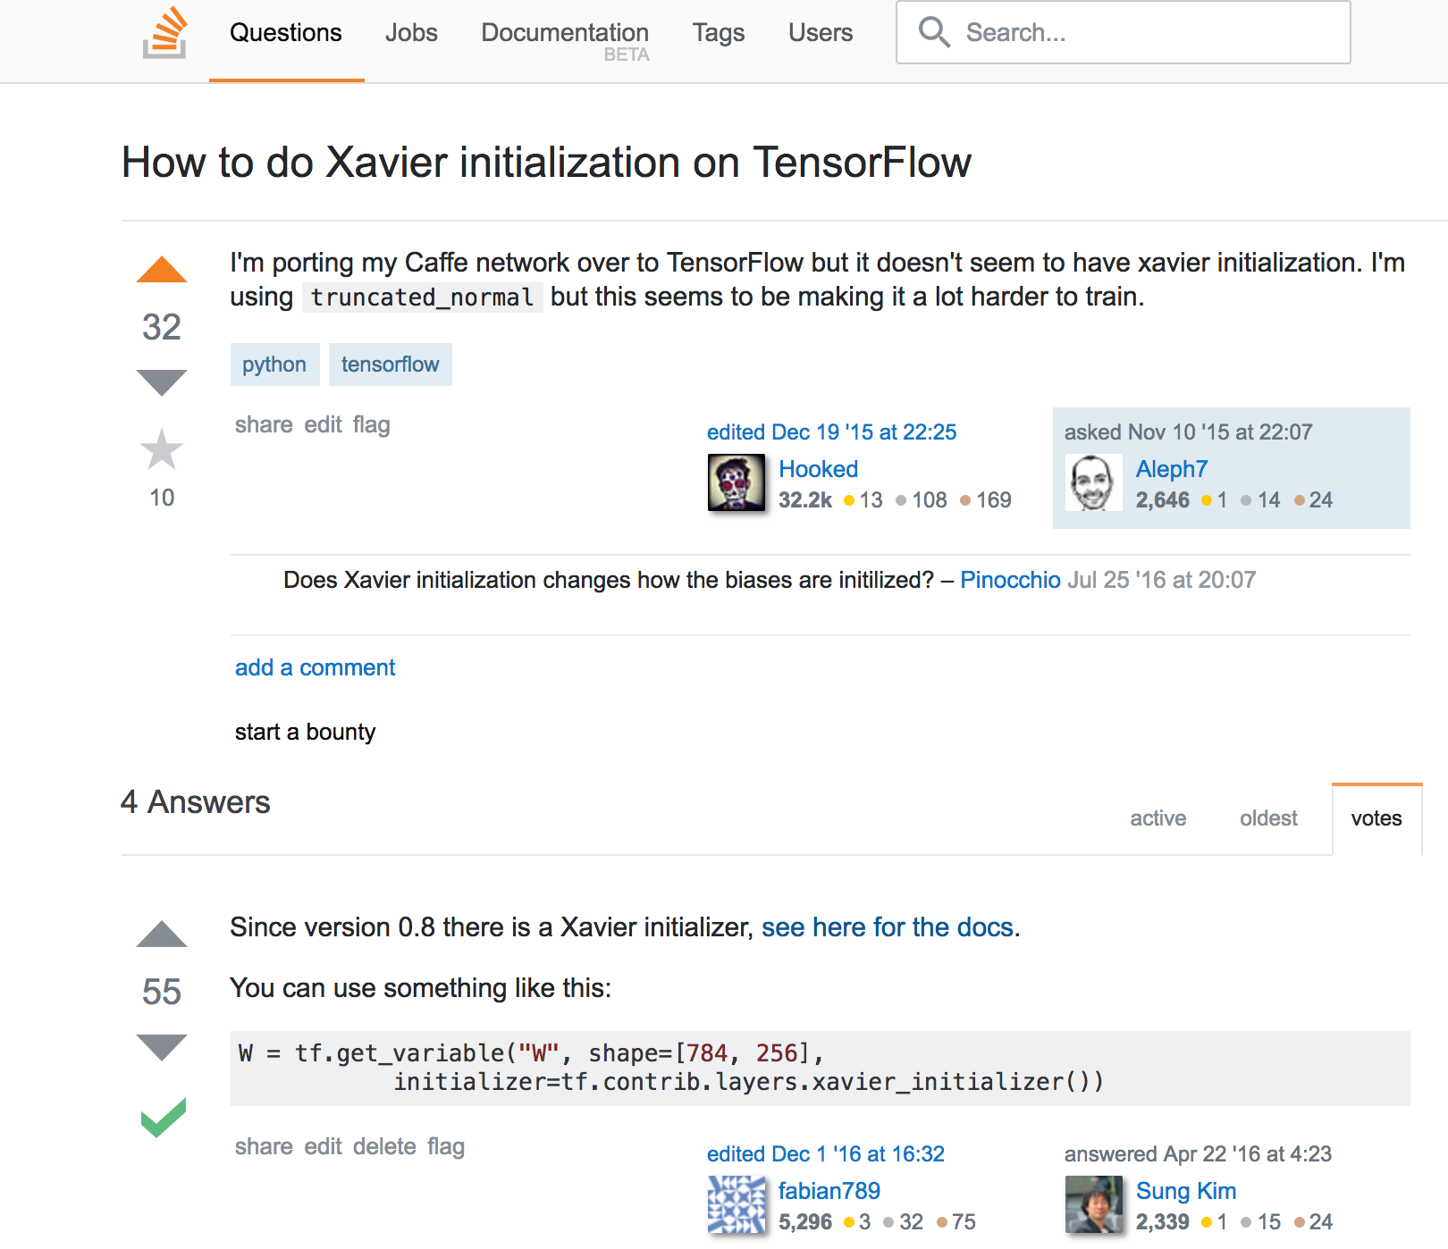
http://stackoverflow.com/questions/33640581/how-to-do-xavier-initialization-on-tensorflow

Slide 10
# input place holders
X = tf.placeholder(tf.float32, [None, 784])
Y = tf.placeholder(tf.float32, [None, 10])
# weights & bias for nn layers
# http://stackoverflow.com/questions/33640581
W1 = tf.get_variable("W1", shape=[784, 256],
initializer=tf.contrib.layers.xavier_initializer())
b1 = tf.Variable(tf.random_normal([256]))
L1 = tf.nn.relu(tf.matmul(X, W1) + b1)
W2 = tf.get_variable("W2", shape=[256, 256],
initializer=tf.contrib.layers.xavier_initializer())
b2 = tf.Variable(tf.random_normal([256]))
L2 = tf.nn.relu(tf.matmul(L1, W2) + b2)
W3 = tf.get_variable("W3", shape=[256, 10],
initializer=tf.contrib.layers.xavier_initializer())
b3 = tf.Variable(tf.random_normal([10]))
hypothesis = tf.matmul(L2, W3) + b3
# define cost/loss & optimizer
cost = tf.reduce_mean(tf.nn.softmax_cross_entropy_with_logits(
logits=hypothesis, labels=Y))
optimizer = tf.train.AdamOptimizer(learning_rate=learning_rate).minimize(cost)
Xavier for MNIST
Epoch: 0001 cost = 0.301498963
Epoch: 0002 cost = 0.107252513
Epoch: 0003 cost = 0.064888892
Epoch: 0004 cost = 0.044463030
Epoch: 0005 cost = 0.029951642
Epoch: 0006 cost = 0.020663404
Epoch: 0007 cost = 0.015853033
Epoch: 0008 cost = 0.011764387
Epoch: 0009 cost = 0.008598264
Epoch: 0010 cost = 0.007383116
Epoch: 0011 cost = 0.006839140
Epoch: 0012 cost = 0.004672963
Epoch: 0013 cost = 0.003979437
Epoch: 0014 cost = 0.002714260
Epoch: 0015 cost = 0.004707661
Learning Finished!
Accuracy: 0.9783
https://github.com/hunkim/DeepLearningZeroToAll/blob/master/lab-10-3-mnist_nn_xavier.py

Slide 11
# input place holders
X = tf.placeholder(tf.float32, [None, 784])
Y = tf.placeholder(tf.float32, [None, 10])
# weights & bias for nn layers
# http://stackoverflow.com/questions/33640581
W1 = tf.get_variable("W1", shape=[784, 256],
initializer=tf.contrib.layers.xavier_initializer())
b1 = tf.Variable(tf.random_normal([256]))
L1 = tf.nn.relu(tf.matmul(X, W1) + b1)
W2 = tf.get_variable("W2", shape=[256, 256],
initializer=tf.contrib.layers.xavier_initializer())
b2 = tf.Variable(tf.random_normal([256]))
L2 = tf.nn.relu(tf.matmul(L1, W2) + b2)
W3 = tf.get_variable("W3", shape=[256, 10],
initializer=tf.contrib.layers.xavier_initializer())
b3 = tf.Variable(tf.random_normal([10]))
hypothesis = tf.matmul(L2, W3) + b3
# define cost/loss & optimizer
cost = tf.reduce_mean(tf.nn.softmax_cross_entropy_with_logits(
logits=hypothesis, labels=Y))
optimizer = tf.train.AdamOptimizer(learning_rate=learning_rate).minimize(cost)
Xavier for MNIST
Epoch: 0001 cost = 141.207671860
Epoch: 0002 cost = 38.788445864
Epoch: 0003 cost = 23.977515479
Epoch: 0004 cost = 16.315132428
Epoch: 0005 cost = 11.702554882
Epoch: 0006 cost = 8.573139748
Epoch: 0007 cost = 6.370995680
Epoch: 0008 cost = 4.537178684
Epoch: 0009 cost = 3.216900532
Epoch: 0010 cost = 2.329708954
Epoch: 0011 cost = 1.715552875
Epoch: 0012 cost = 1.189857912
Epoch: 0013 cost = 0.820965160
Epoch: 0014 cost = 0.624131458
Epoch: 0015 cost = 0.454633765
Learning Finished!
Accuracy: 0.9455 (normal dist)
Epoch: 0001 cost = 0.301498963
Epoch: 0002 cost = 0.107252513
Epoch: 0003 cost = 0.064888892
Epoch: 0004 cost = 0.044463030
Epoch: 0005 cost = 0.029951642
Epoch: 0006 cost = 0.020663404
Epoch: 0007 cost = 0.015853033
Epoch: 0008 cost = 0.011764387
Epoch: 0009 cost = 0.008598264
Epoch: 0010 cost = 0.007383116
Epoch: 0011 cost = 0.006839140
Epoch: 0012 cost = 0.004672963
Epoch: 0013 cost = 0.003979437
Epoch: 0014 cost = 0.002714260
Epoch: 0015 cost = 0.004707661
Learning Finished!
Accuracy: 0.9783 (xavier)
https://github.com/hunkim/DeepLearningZeroToAll/blob/master/lab-10-3-mnist_nn_xavier.py

Slide 12
W1 = tf.get_variable("W1", shape=[784, 512],
initializer=tf.contrib.layers.xavier_initializer())
b1 = tf.Variable(tf.random_normal([512]))
L1 = tf.nn.relu(tf.matmul(X, W1) + b1)
W2 = tf.get_variable("W2", shape=[512, 512],
initializer=tf.contrib.layers.xavier_initializer())
b2 = tf.Variable(tf.random_normal([512]))
L2 = tf.nn.relu(tf.matmul(L1, W2) + b2)
W3 = tf.get_variable("W3", shape=[512, 512],
initializer=tf.contrib.layers.xavier_initializer())
b3 = tf.Variable(tf.random_normal([512]))
L3 = tf.nn.relu(tf.matmul(L2, W3) + b3)
W4 = tf.get_variable("W4", shape=[512, 512],
initializer=tf.contrib.layers.xavier_initializer())
b4 = tf.Variable(tf.random_normal([512]))
L4 = tf.nn.relu(tf.matmul(L3, W4) + b4)
W5 = tf.get_variable("W5", shape=[512, 10],
initializer=tf.contrib.layers.xavier_initializer())
b5 = tf.Variable(tf.random_normal([10]))
hypothesis = tf.matmul(L4, W5) + b5
# define cost/loss & optimizer
cost = tf.reduce_mean(tf.nn.softmax_cross_entropy_with_logits(logits=hypothesis, labels=Y))
optimizer = tf.train.AdamOptimizer(learning_rate=learning_rate).minimize(cost)
Deep NN for MNIST
Epoch: 0001 cost = 0.266061549
Epoch: 0002 cost = 0.080796588
Epoch: 0003 cost = 0.049075800
Epoch: 0004 cost = 0.034772298
Epoch: 0005 cost = 0.024780529
Epoch: 0006 cost = 0.017072763
Epoch: 0007 cost = 0.014031383
Epoch: 0008 cost = 0.013763446
Epoch: 0009 cost = 0.009164047
Epoch: 0010 cost = 0.008291388
Epoch: 0011 cost = 0.007319742
Epoch: 0012 cost = 0.006434021
Epoch: 0013 cost = 0.005684378
Epoch: 0014 cost = 0.004781207
Epoch: 0015 cost = 0.004342310
Learning Finished!
Accuracy: 0.9742
https://github.com/hunkim/DeepLearningZeroToAll/blob/master/lab-10-4-mnist_nn_deep.py
Notes:
Overfitting?

Slide 13
# dropout (keep_prob) rate 0.7 on training, but should be 1 for testing
keep_prob = tf.placeholder(tf.float32)
W1 = tf.get_variable("W1", shape=[784, 512])
b1 = tf.Variable(tf.random_normal([512]))
L1 = tf.nn.relu(tf.matmul(X, W1) + b1)
L1 = tf.nn.dropout(L1, keep_prob=keep_prob)
W2 = tf.get_variable("W2", shape=[512, 512])
b2 = tf.Variable(tf.random_normal([512]))
L2 = tf.nn.relu(tf.matmul(L1, W2) + b2)
L2 = tf.nn.dropout(L2, keep_prob=keep_prob)
…
# train my model
for epoch in range(training_epochs):
...
for i in range(total_batch):
batch_xs, batch_ys = mnist.train.next_batch(batch_size)
feed_dict = {X: batch_xs, Y: batch_ys, keep_prob: 0.7}
c, _ = sess.run([cost, optimizer], feed_dict=feed_dict)
avg_cost += c / total_batch
# Test model and check accuracy
correct_prediction = tf.equal(tf.argmax(hypothesis, 1), tf.argmax(Y, 1))
accuracy = tf.reduce_mean(tf.cast(correct_prediction, tf.float32))
print('Accuracy:', sess.run(accuracy, feed_dict={
X: mnist.test.images, Y: mnist.test.labels, keep_prob: 1}))
Dropout for MNIST
Epoch: 0001 cost = 0.447322626
Epoch: 0002 cost = 0.157285590
Epoch: 0003 cost = 0.121884535
Epoch: 0004 cost = 0.098128681
Epoch: 0005 cost = 0.082901778
Epoch: 0006 cost = 0.075337573
Epoch: 0007 cost = 0.069752543
Epoch: 0008 cost = 0.060884363
Epoch: 0009 cost = 0.055276413
Epoch: 0010 cost = 0.054631256
Epoch: 0011 cost = 0.049675195
Epoch: 0012 cost = 0.049125314
Epoch: 0013 cost = 0.047231930
Epoch: 0014 cost = 0.041290121
Epoch: 0015 cost = 0.043621063
Learning Finished!
Accuracy: 0.9804!!
https://github.com/hunkim/DeepLearningZeroToAll/blob/master/lab-10-5-mnist_nn_dropout.py

Slide 14
Optimizers
train = tf.train.GradientDescentOptimizer(learning_rate=0.1).minimize(cost)
https://www.tensorflow.org/api_guides/python/train

Slide 15
Optimizers
train = tf.train.GradientDescentOptimizer(learning_rate=0.1).minimize(cost)
tf.train.AdadeltaOptimizer
tf.train.AdagradOptimizer
tf.train.AdagradDAOptimizer
tf.train.MomentumOptimizer
tf.train.AdamOptimizer
tf.train.FtrlOptimizer
tf.train.ProximalGradientDescentOptimizer
tf.train.ProximalAdagradOptimizer
tf.train.RMSPropOptimizer
https://www.tensorflow.org/api_guides/python/train

Slide 16
http://www.denizyuret.com/2015/03/alec-radfords-animations-for.html

Slide 17
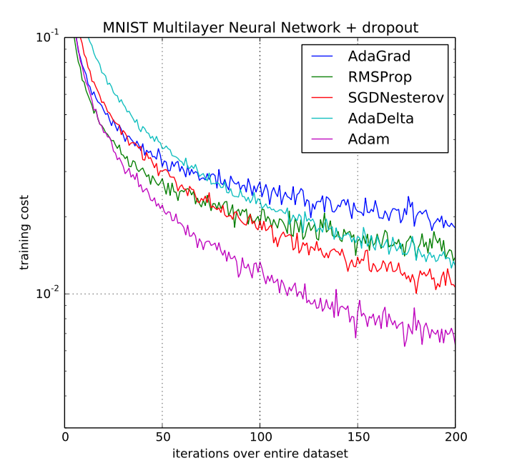
ADAM: a method for stochastic optimization
[Kingma et al. 2015]

Slide 18
Use Adam Optimizer
# define cost/loss & optimizer
cost = tf.reduce_mean(tf.nn.softmax_cross_entropy_with_logits(
logits=hypothesis, labels=Y))
optimizer = tf.train.AdamOptimizer(learning_rate=learning_rate).minimize(cost)

Slide 19
Summary
Softmax VS Neural Nets for MNIST, 90% and 94.5%
Xavier initialization: 97.8%
Deep Neural Nets with Dropout: 98%
Adam and other optimizers
Exercise: Batch Normalization
https://github.com/hunkim/DeepLearningZeroToAll/blob/master/lab-10-6-mnist_nn_batchnorm.ipynb

Slide 20
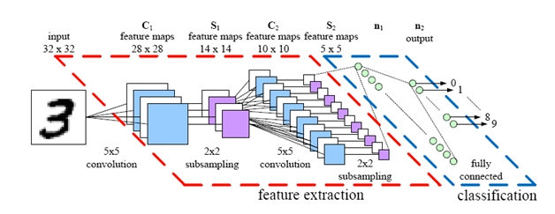
Lecture and Lab 11
CNN
Sung Kim <hunkim+ml@gmail.com>
http://hunkim.github.io/ml/

